Slide 1
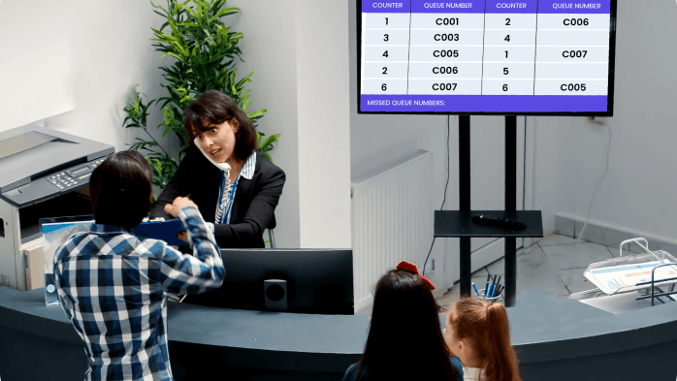

QUEUE MANAGEMENT SYSTEM
FOR COLLEGE OFFICES
Jyothi Harshini M | S Divyasri | P Janaki | PV Lalitha Mani
Pragati Engineering College | CSE Department

Slide 2
Abstract
Introduction
Objectives
Architecture
Features
Database
Implementation
Advantages
Abstract
The Queue Management System for College Offices is a web-based application designed to improve the efficiency and organization of administrative services within educational institutions.
In traditional systems, students often face long waiting times and overcrowding in offices such as the registrar, accounts, and help desk.
This project addresses these challenges by introducing a digital token-based system that allows students to join queues remotely and enables administrators to manage service flow effectively.
Key Highlights
Frontend: Next.js
Backend: Supabase
Database: PostgreSQL
Features: Real-time updates, token generation, admin dashboard
Benefits: Reduced waiting time, improved transparency

Slide 3

Abstract
Introduction
Objectives
Architecture
Features
Database
Implementation
Advantages
Introduction
In many colleges, administrative offices handle a large number of student requests daily, including fee payments, certificate requests, and general inquiries.
Traditional queue systems rely on physical presence and manual management, which leads to inefficiencies such as long waiting times, confusion, and lack of transparency.
With the advancement of digital technologies, there is a need to modernize these systems.
The proposed system replaces manual processes with an automated and user-friendly solution, allowing students to generate tokens online and track their position in the queue.

Slide 4
Abstract
Introduction
Objectives
Architecture
Features
Database
Implementation
Advantages
Objectives
Minimize Waiting Time
Introduce a digital queue system to reduce student waiting times.
Eliminate Crowding
Remove physical crowding in administrative areas.
Ensure Transparency
Provide a transparent and organized method of handling requests.
Primary Goal
Design and implement an efficient queue management system that enhances the overall functioning of college administrative offices.
Centralized Dashboard
Enable administrators to manage queues efficiently.
Record Management
Maintain records of completed tokens for future analysis.

Slide 5
Abstract
Introduction
Objectives
Architecture
Features
Database
Implementation
Advantages
System Architecture
CLIENT SIDE
SERVER SIDE
DATABASE
Next.js Frontend
User interface for students and administrators.
Students can generate tokens, while administrators can manage queues and view history.
Supabase Backend
Handles database operations: inserting, updating, and retrieving token data.
Real-time data synchronization and secure storage.
PostgreSQL Database
Stores all token information including status and timestamps.
Real-time updates ensure immediate UI reflection.

Slide 6
Abstract
Introduction
Objectives
Architecture
Features
Database
Implementation
Advantages
Features
Online Token Generation
Students can generate tokens online without physically standing in line.
Unique Token Numbers
Each token is assigned a unique number for easy identification.
Admin Dashboard
Administrators can call, complete, or manage tokens from a central view.
Real-Time Updates
Users are always aware of their queue status with live updates.
History Tracking
Completed tokens are stored for tracking and analysis.
Multi-Service Support
Suitable for different administrative needs across offices.

Slide 7
Abstract
Introduction
Objectives
Architecture
Features
Database
Implementation
Advantages
Database Design
The system uses a relational database to store queue-related data. The main table is the tokens table.
Field | Type | Description
id | UUID (Primary Key) | Unique identifier for each token
token_number | String | The generated token number
student_name | String | Name of the student
roll_number | String | Student's roll number
status | Enum | pending / active / completed
created_at | Timestamp | When the token was generated
completed_at | Timestamp | When the service was completed

Slide 8
Abstract
Introduction
Objectives
Architecture
Features
Database
Implementation
Advantages
Implementation
Frontend
Backend
Built with React components within the Next.js framework, providing a dynamic and responsive interface.
API calls handle token insertion, status updates, and data retrieval.
Supabase serves as the backend service, enabling seamless interaction with the database.
Real-time data synchronization ensures immediate UI updates.
Admin Dashboard
The admin dashboard allows administrators to view the current queue, call the next token, mark tokens as completed, and access the history of completed tokens.
All operations are performed in real time, improving efficiency and accuracy.

Slide 9
Abstract
Introduction
Objectives
Architecture
Features
Database
Implementation
Advantages
Advantages & Future Scope
ADVANTAGES
FUTURE ENHANCEMENTS
■ Reduces overcrowding in college offices
■ Improves efficiency by automating queue management
■ Provides transparency with queue tracking
■ Maintains digital records for analysis
■ Enhances user experience for students and staff
■ SMS and email notifications for students
■ Advanced filtering and search in history
■ Analytics dashboard for performance monitoring
■ Mobile application for easier access
■ Integration with college authentication systems

Slide 10
THANK YOU
QUEUE MANAGEMENT SYSTEM
Jyothi Harshini M | S Divyasri | P Janaki | PV Lalitha Mani
Department of Computer Science and Engineering
Pragati Engineering College

